Slide 1

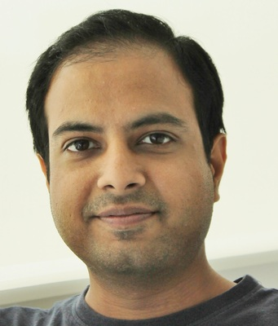

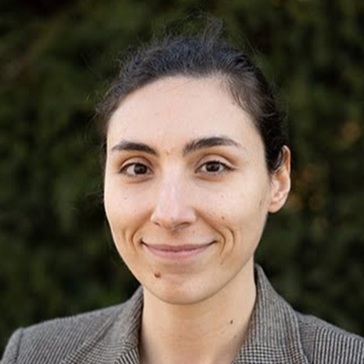
Deep Learning for Brain Encoding and Decoding
Subba Reddy Oota¹, Manish Gupta^{2,3}, Raju S. Bapi², Mariya Toneva⁴
¹Inria Bordeaux, France; ²IIIT Hyderabad, India; ³Microsoft, India; ⁴MPI for Software Systems, Germany
subba-reddy.oota@inria.fr, gmanish@microsoft.com, raju.bapi@iiit.ac.in, mtoneva@mpi-sws.org

Slide 2
Agenda
Introduction to Brain encoding and decoding [30 min]
Stimulus Representations [1 hour 30 min]
Coffee break [30 min]
Deep Learning for Brain Decoding [1 hour 30 min]
Lunch break [1 hour 15 min]
Deep Learning for Brain Encoding [1 hour 30 min]
Coffee break [30 min]
Advanced Methods [1 hour 15 min]
Summary and Future Trends [15 min]

Slide 3
Challenges in using DL for cognitive modeling
Not designed to specifically model brain processing
NLP systems: Designed to predict upcoming words
Harry never thought ???
Harry never thought he ???
Harry never thought he would ???
...

Slide 4
Challenges in using DL for cognitive modeling
Not designed to specifically model brain processing
Training DL models using brain recordings
Task-based modeling

Slide 5
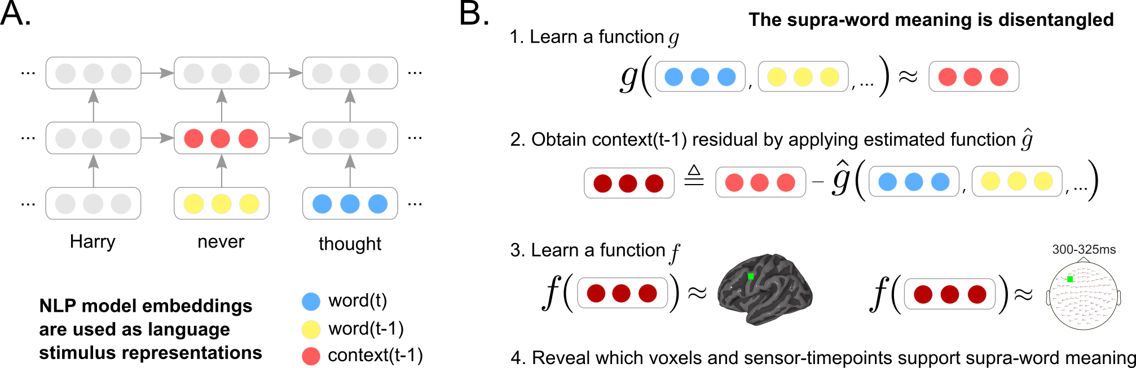
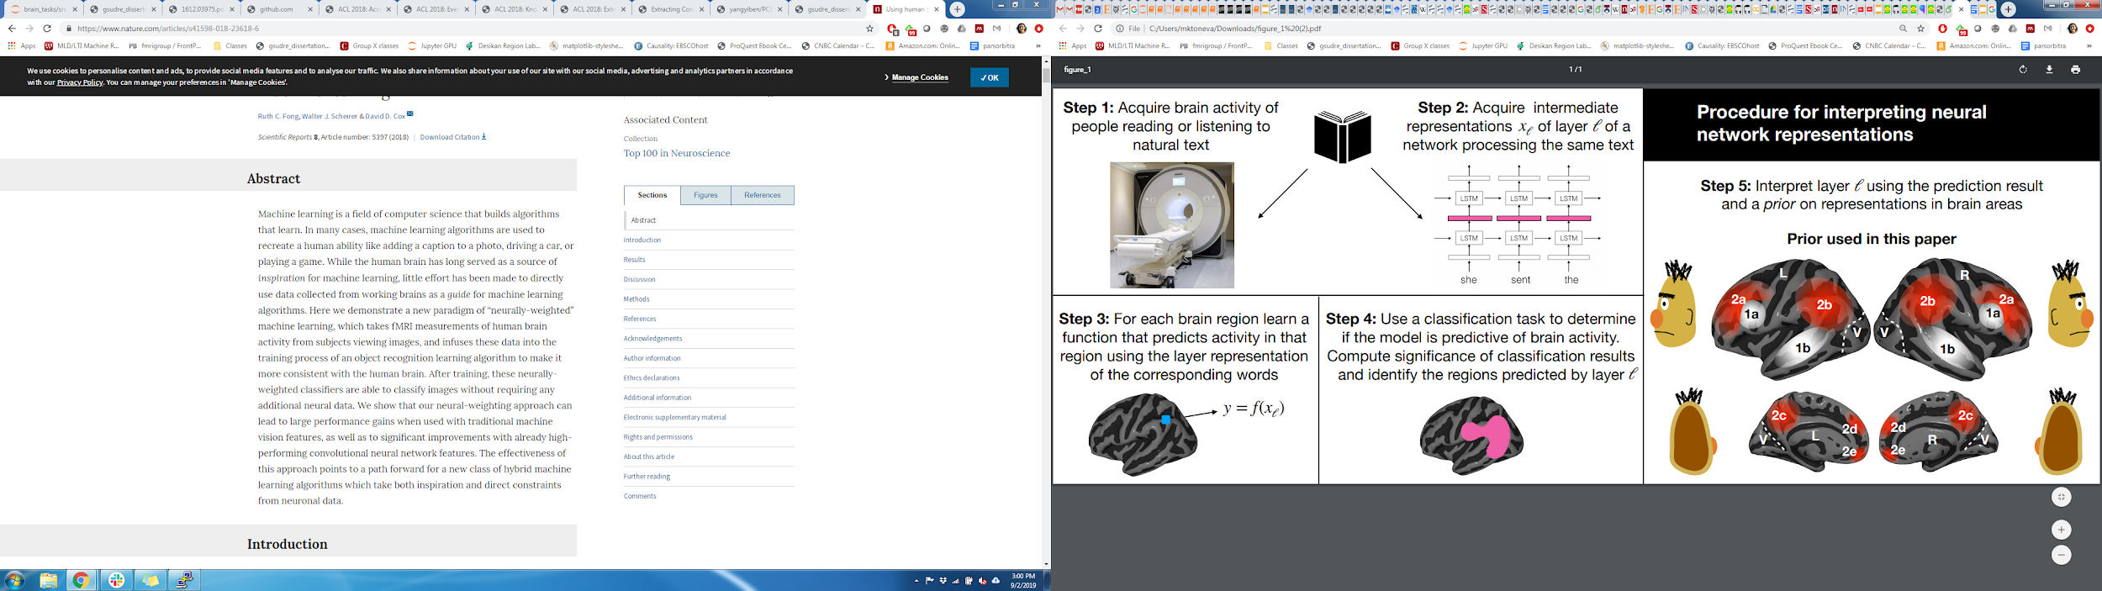
Challenges in using DL for cognitive science
Not designed to specifically model brain processing
Training DL models using brain recordings
Task-based modeling
Can be difficult to interpret due to multiple sources of information
part-of-speech
+
semantic role
?
+
dependence on other words
+
...

Slide 6
Challenges in using DL for cognitive science
Not designed to specifically model brain processing
Training DL models using brain recordings
Task-based modeling
Can be difficult to interpret due to multiple sources of information
Disentangling contributions of different info sources to brain predictions

Slide 7
Challenges in using DL for cognitive science
Not designed to specifically model brain processing
Training DL models using brain recordings
Task-based modeling
Can be difficult to interpret due to multiple sources of information
Disentangling contributions of different info sources to brain predictions

Slide 8
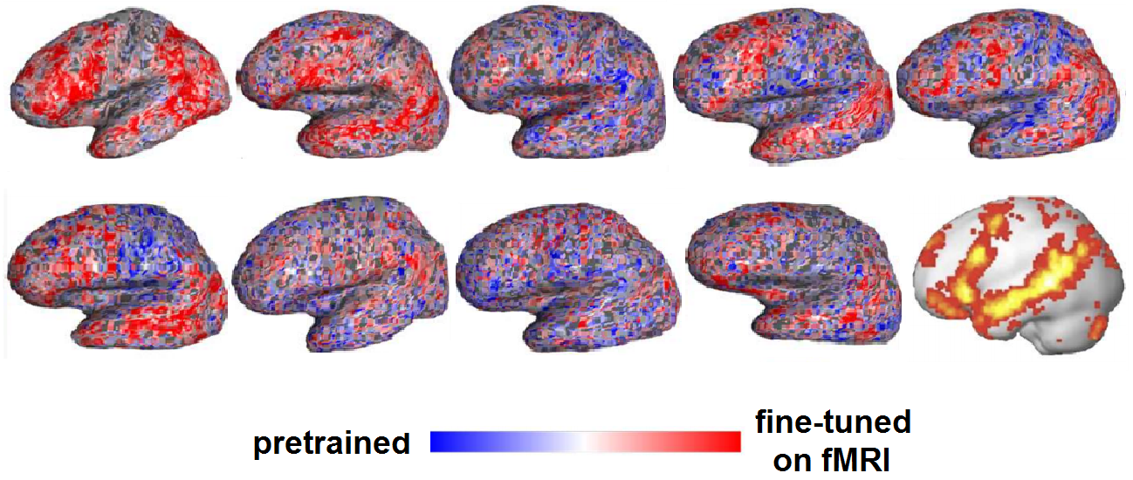
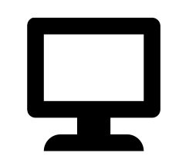

Training DL models using brain recordings
Stimuli: one chapter of Harry Potter
Stimulus representation: brain-optimized NLP model
Brain recording & modality: fMRI & MEG, reading
Chapter of a book
NLP system
A priori locations in NLP system and brain
error propagation
Brain-optimized NLP model predicts unseen fMRI recordings better, especially in canonical language regions
𝑥 alignment
fMRI
Schwartz, Dan, Mariya Toneva, and Leila Wehbe. "Inducing brain-relevant bias in natural language processing models." Advances in neural information processing systems 32 (2019).

Slide 9
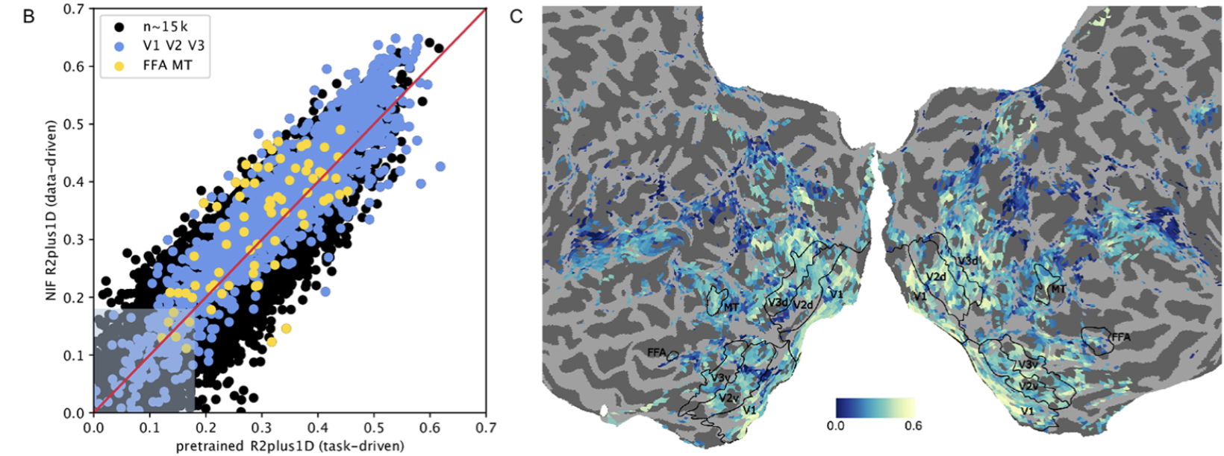
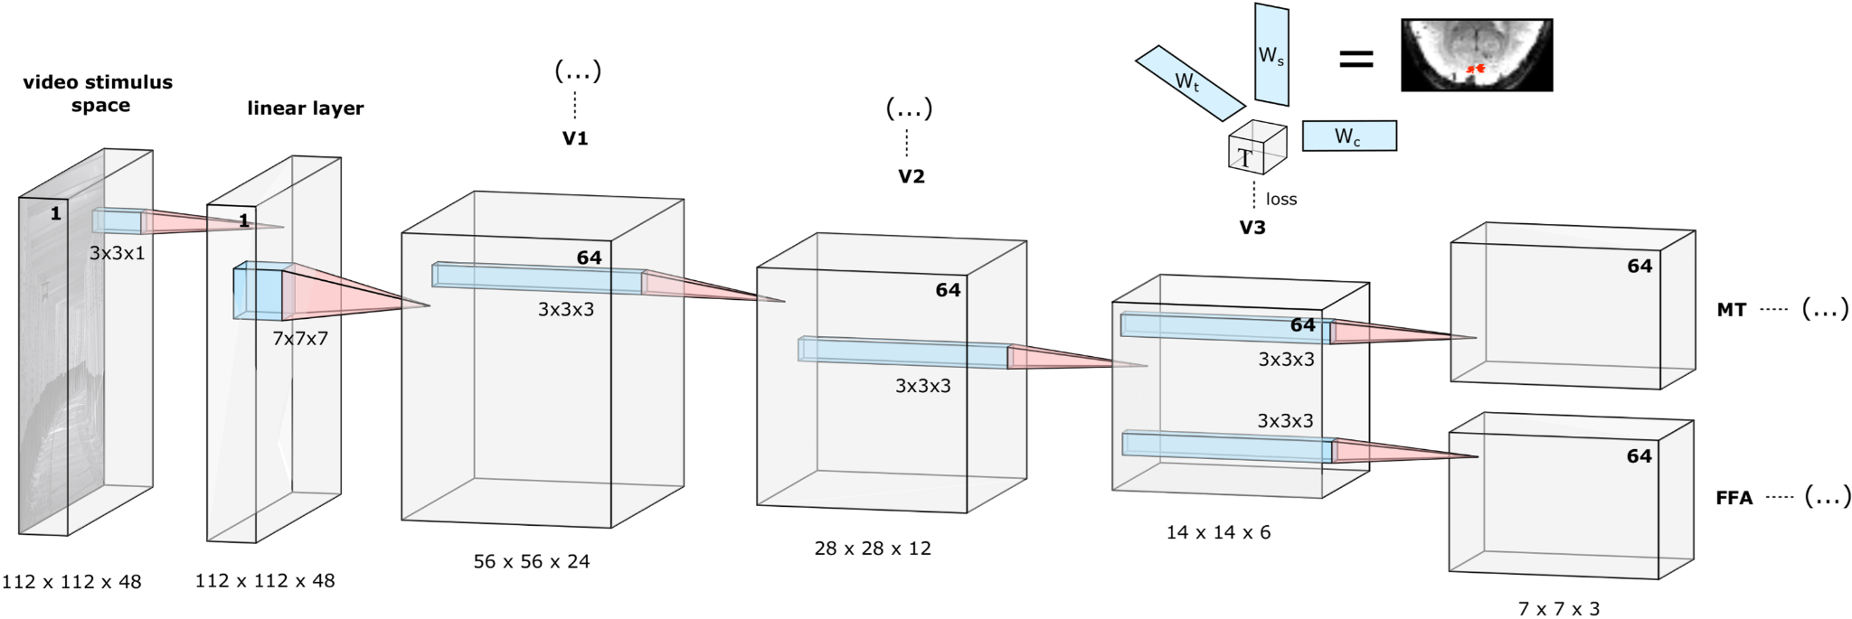
Training DL models using brain recordings
Stimuli: movie and TV show clips
Stimulus representation: brain-optimized CNN
Brain recording & modality: fMRI, vision
Brain-optimized vision model trained entirely on fMRI recordings ~= task-optimized networks for predicting brain recordings in early and high-level ROI
Seeliger, Katja, Luca Ambrogioni, Yağmur Güçlütürk, Leonieke M. van den Bulk, Umut Güçlü, and Marcel AJ van Gerven. "End-to-end neural system identification with neural information flow." PLOS Computational Biology 17, no. 2 (2021): e1008558.

Slide 10
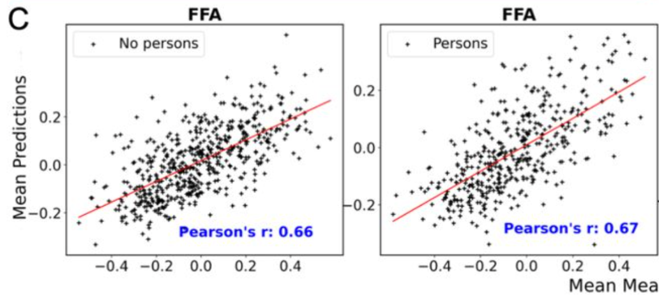
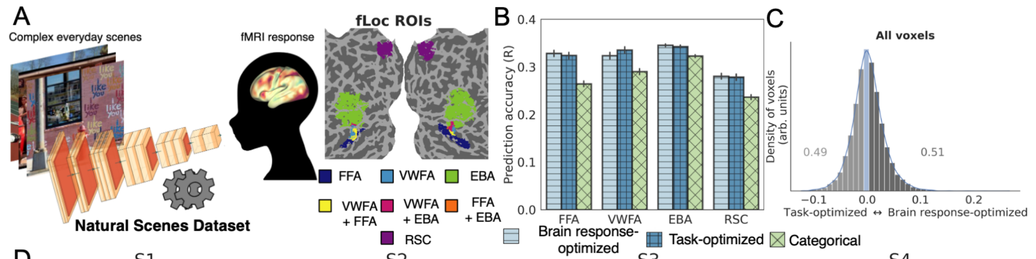
Training DL models using brain recordings
Stimuli: images natural scenes
Stimulus representation: brain-optimized CNN
Brain recording & modality: fMRI, vision
Brain-optimized vision model can predict brain signals corresponding to a category of stimuli that it was never trained on
Khosla, Meenakshi, and Leila Wehbe. "High-level visual areas act like domain-general filters with strong selectivity and functional specialization." bioRxiv (2022).

Slide 11
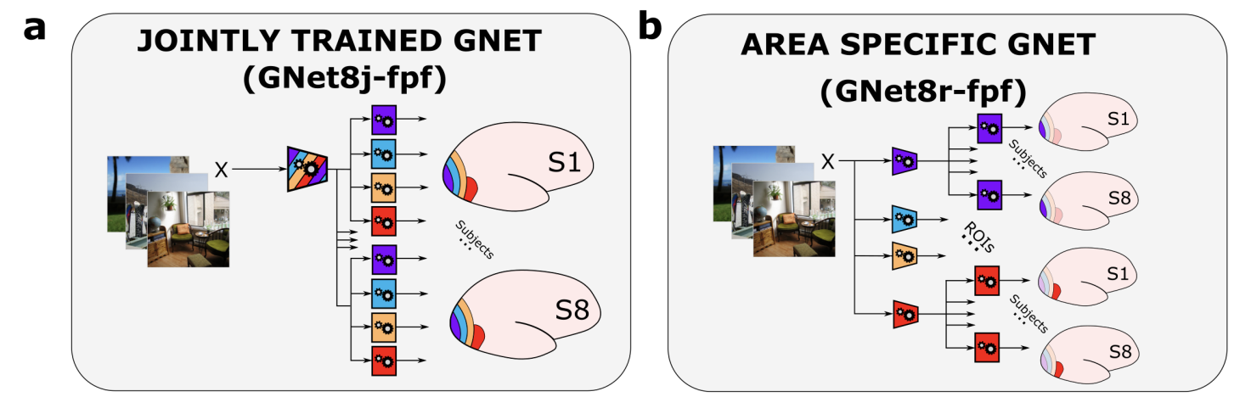
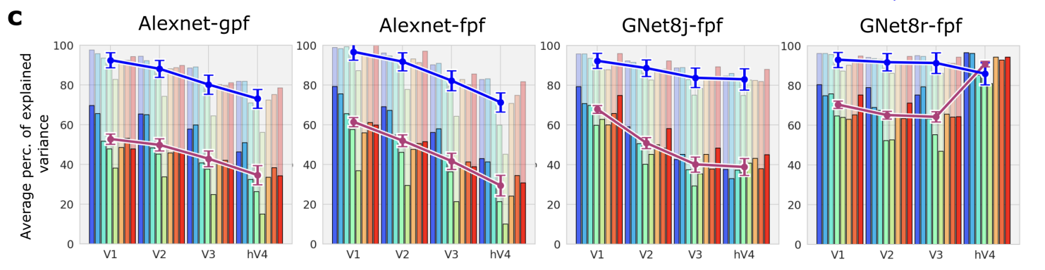
Training DL models using brain recordings
Stimuli: images natural scenes
Stimulus representation: brain-optimized CNN
Brain recording & modality: fMRI, vision
Brain-optimized vision model can learn representations that do not follow a strict hierarchy
St-Yves, Ghislain, Emily J. Allen, Yihan Wu, Kendrick Kay, and Thomas Naselaris. "Brain-optimized neural networks learn non-hierarchical models of representation in human visual cortex." Nature Communications (2023).

Slide 12
Challenges in using DL for cognitive modeling
Not designed to specifically model brain processing
Training DL models using brain recordings
Task-based modeling
Can be difficult to interpret due to multiple sources of information
Disentangling contributions of different info sources to brain predictions

Slide 13
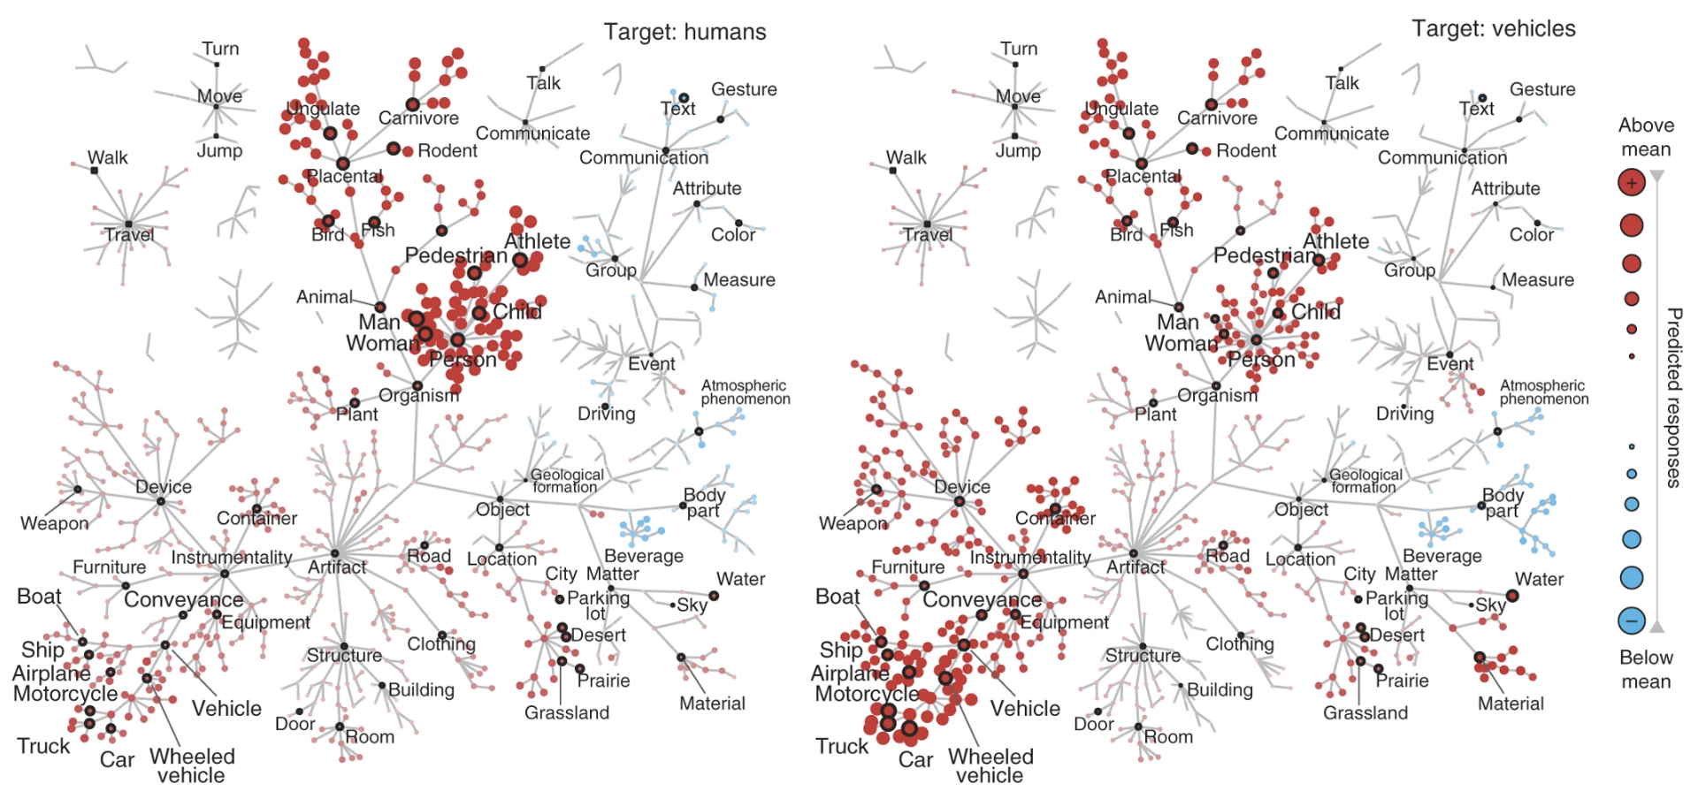
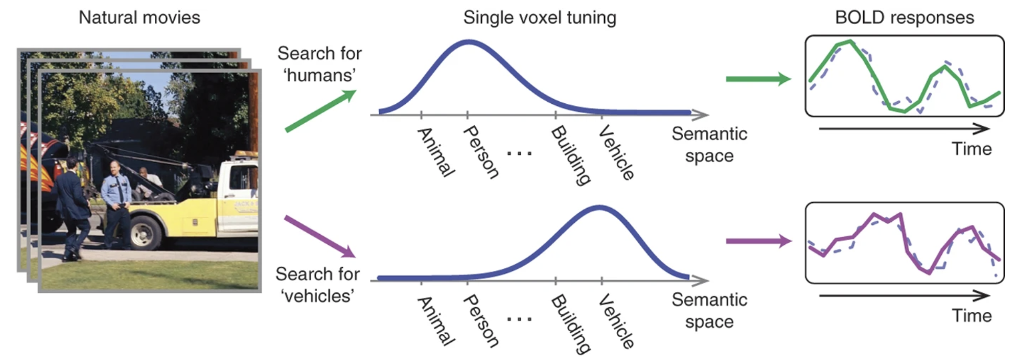
Tasks affect processing
Stimuli: natural movies
Task: visual search for vehicles or humans
Stimulus representation: object and action labels from WordNet
Brain recording & modality: fMRI, vision
Category-based attention during natural vision alters representation of both attended and unattended categories
Çukur, Tolga, Shinji Nishimoto, Alexander G. Huth, and Jack L. Gallant. "Attention during natural vision warps semantic representation across the human brain." Nature neuroscience 16, no. 6 (2013): 763-770.

Slide 14
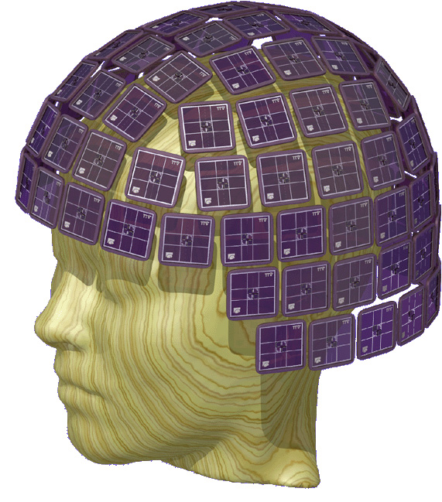
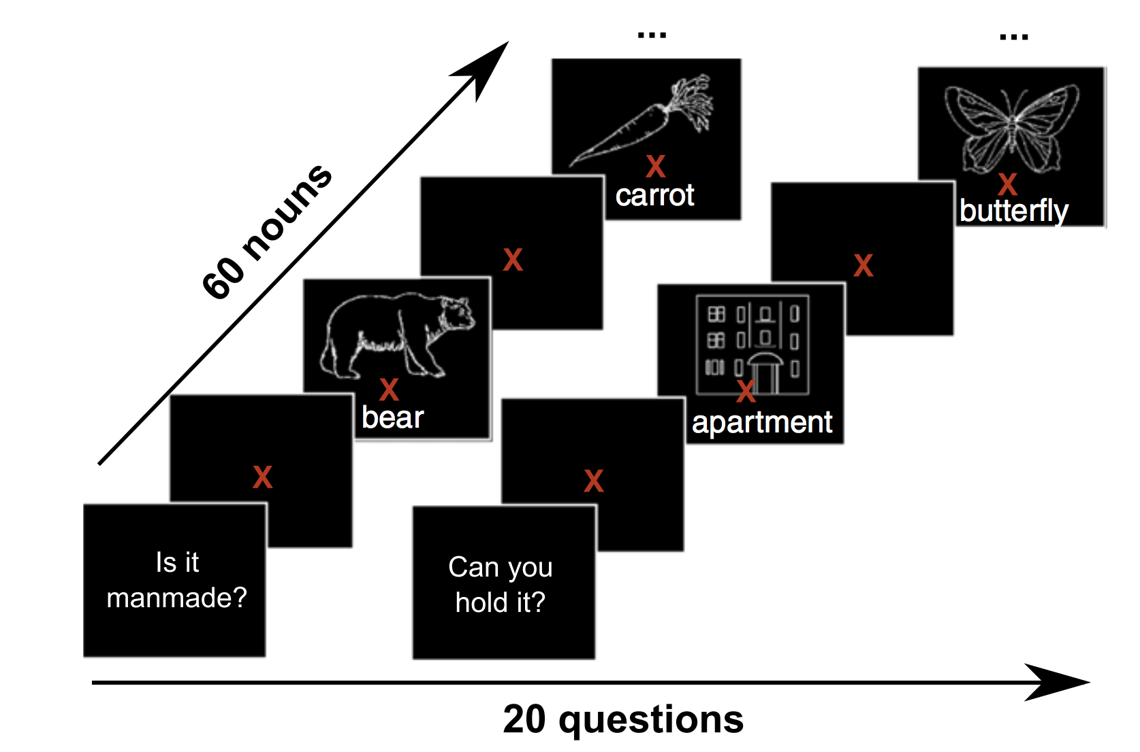
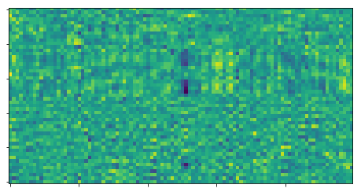
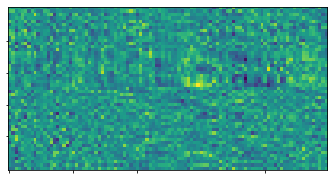
Tasks affect processing
bear
306 sensors
X
800ms
Can we model as a function of the task AND stimulus?
veg?
Systematic difference due to different question tasks
bear
306 sensors
X
800ms
tool?
Attention emphasizes task-relevant information
Mechanism?
Toneva, Mariya, Otilia Stretcu, Barnabás Póczos, Leila Wehbe, and Tom M. Mitchell. "Modeling task effects on meaning representation in the brain via zero-shot meg prediction." Advances in Neural Information Processing Systems 33 (2020): 5284-5295.

Slide 15
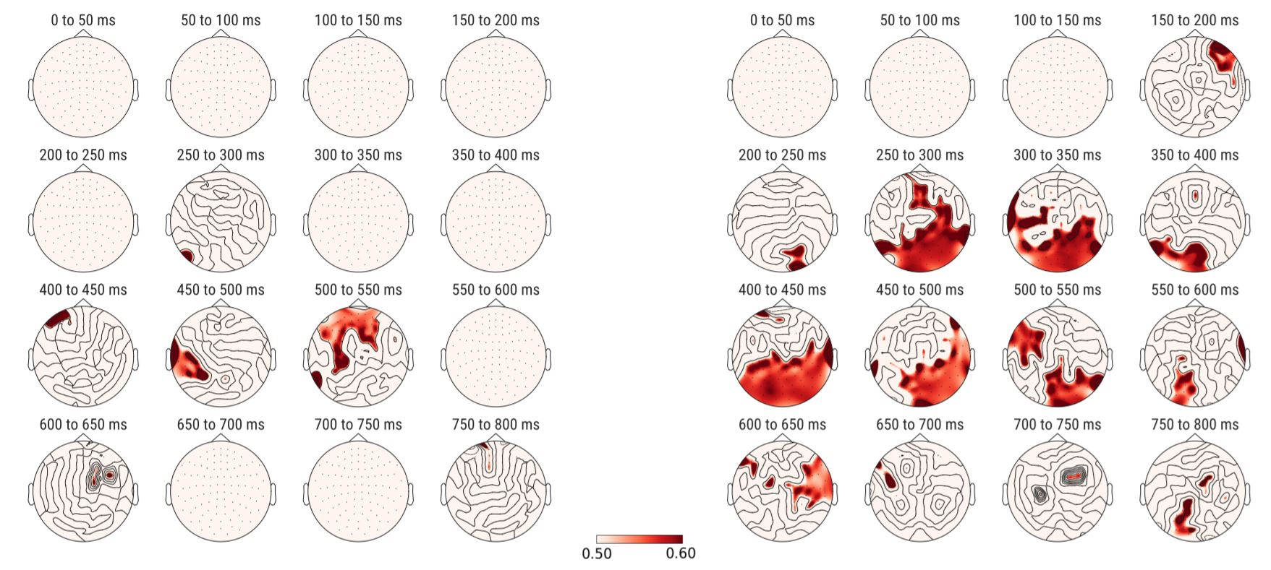
Tasks affect processing
The end of semantic processing of a word is task-dependent
Stimuli: concrete nouns + line drawings
Task: answer Yes/No questions about noun
Stimulus representation: human judgments
Brain recording & modality: MEG, reading
question task effect word effect
significant prediction performance
Toneva, Mariya, Otilia Stretcu, Barnabás Póczos, Leila Wehbe, and Tom M. Mitchell. "Modeling task effects on meaning representation in the brain via zero-shot meg prediction." Advances in Neural Information Processing Systems 33 (2020): 5284-5295.

Slide 16
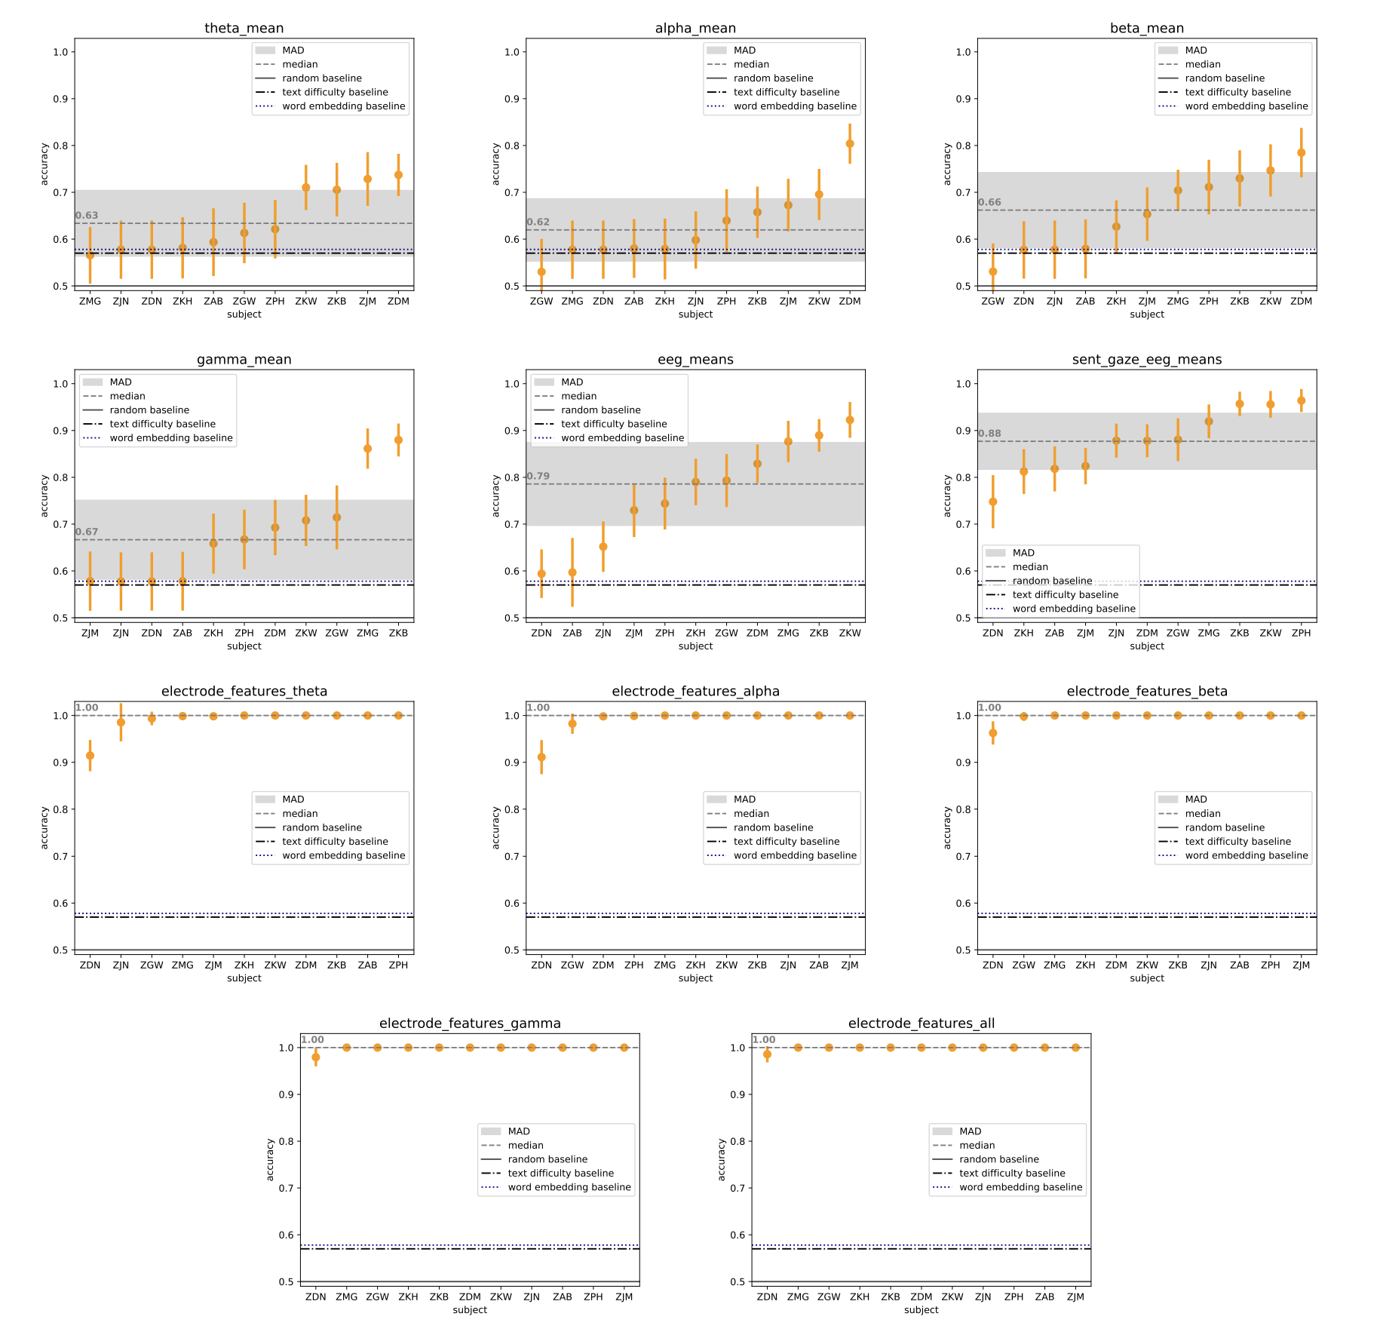
Tasks affect processing
Stimuli: sentences
Task: searching for specific relations
Stimulus representation: word embeddings
Brain recording & modality: EEG, reading
Possible to predict whether a person is passively reading or performing a task with the text based on EEG recordings
Hollenstein, Nora, Marius Tröndle, Martyna Plomecka, Samuel Kiegeland, Yilmazcan Özyurt, Lena A. Jäger, and Nicolas Langer. "Reading task classification using EEG and eye-tracking data." arXiv preprint arXiv:2112.06310 (2021).

Slide 17
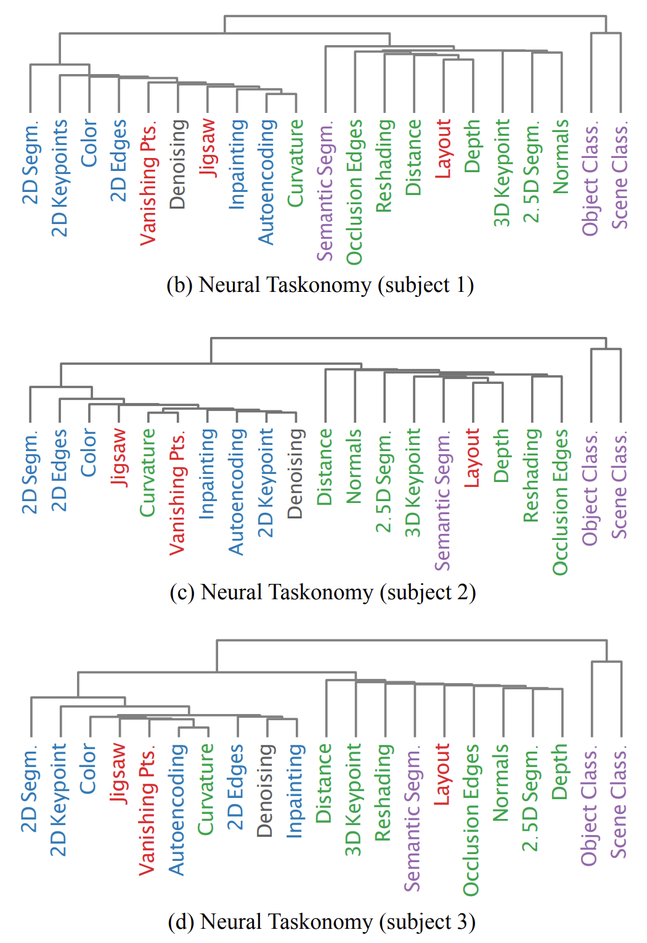
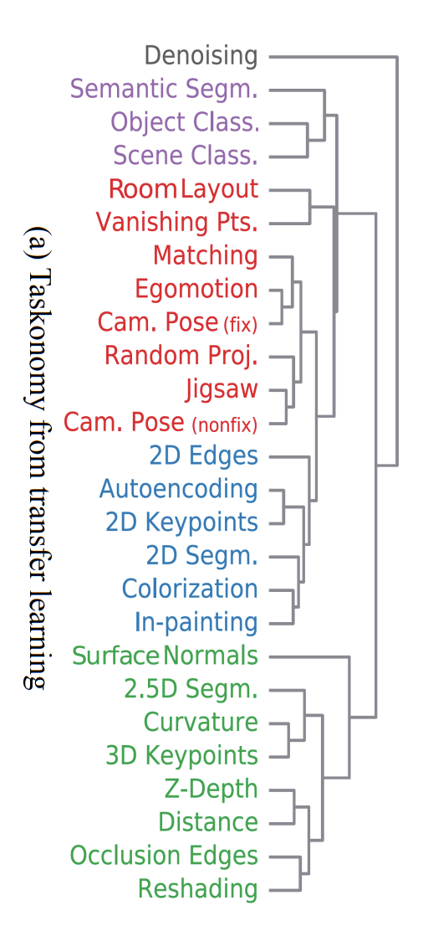
Tasks affect processing
Semantic Low-dim. Geometric 2D 3D
Stimuli: images of natural scenes
Stimulus representation: task-optimized CNNs for a range of tasks
Brain recording & modality: fMRI, vision
Vision tasks with higher transferability make similar predictions for brain responses from different regions
Wang, Aria, Michael Tarr, and Leila Wehbe. "Neural taskonomy: Inferring the similarity of task-derived representations from brain activity." Advances in Neural Information Processing Systems 32 (2019).

Slide 18
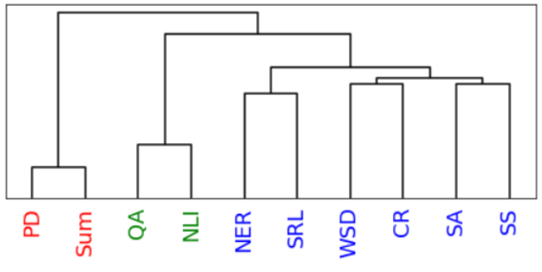
Tasks affect processing
Stimuli: passages and narratives
Stimulus representation: task-optimized NLP models for a range of tasks
Brain recording & modality: fMRI, reading & listening of different stimuli
Reading fMRI best explained by coref. resolution, NER, shallow syntax parsing
Listening fMRI best explained by paraphrasing, summarization, NLI
Oota, Subba Reddy, Jashn Arora, Veeral Agarwal, Mounika Marreddy, Manish Gupta, and Bapi Raju Surampudi. "Neural Language Taskonomy: Which NLP Tasks are the most Predictive of fMRI Brain Activity?." arXiv preprint arXiv:2205.01404 (2022).

Slide 19

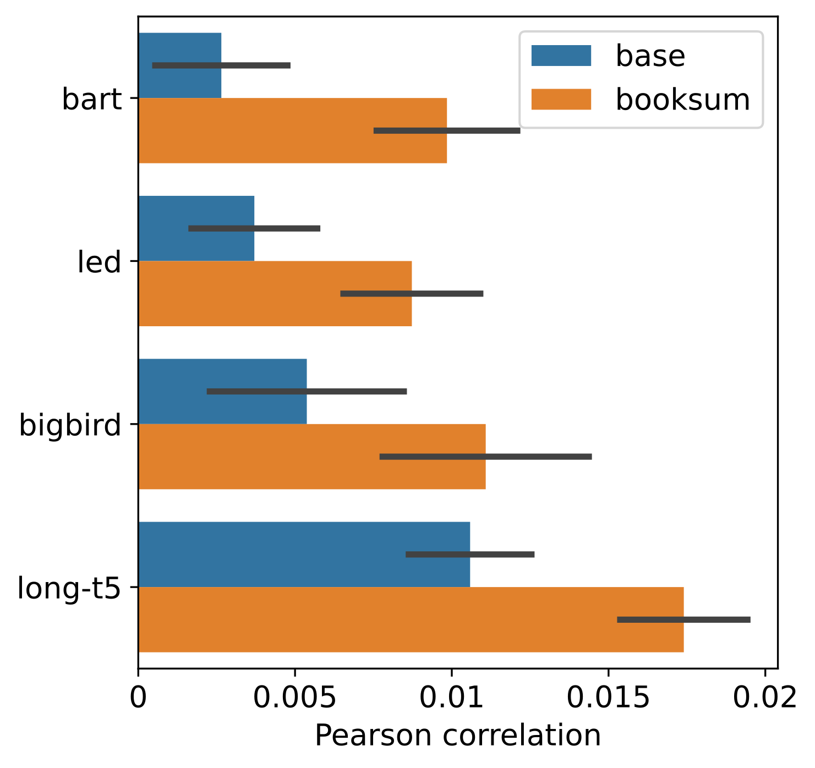
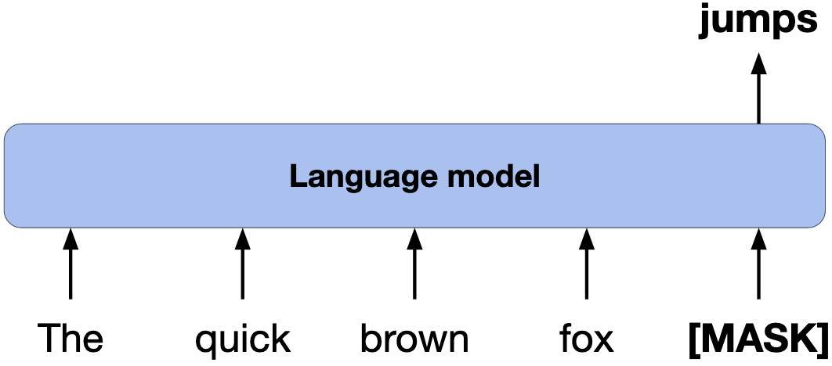
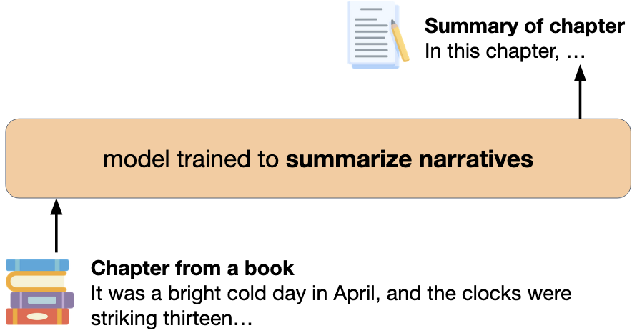
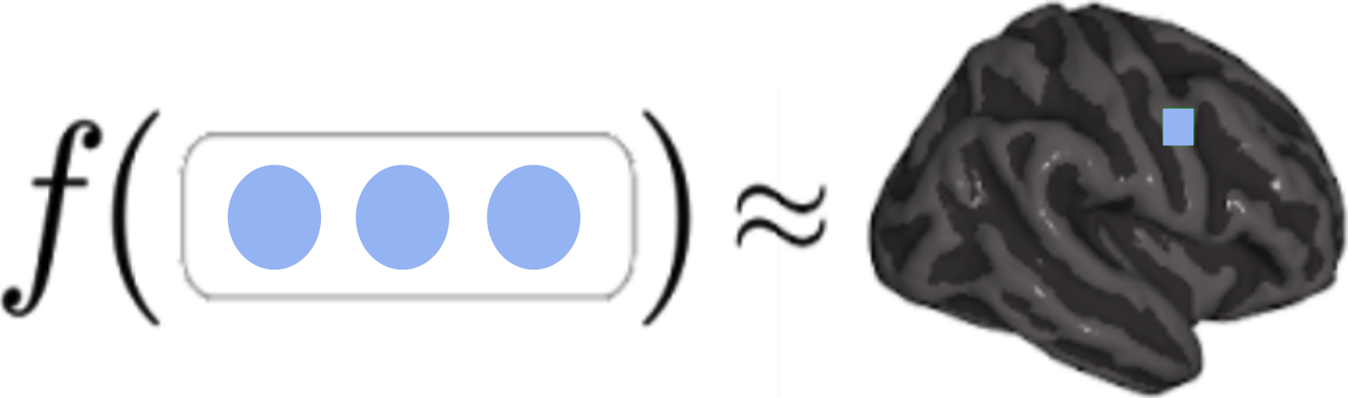
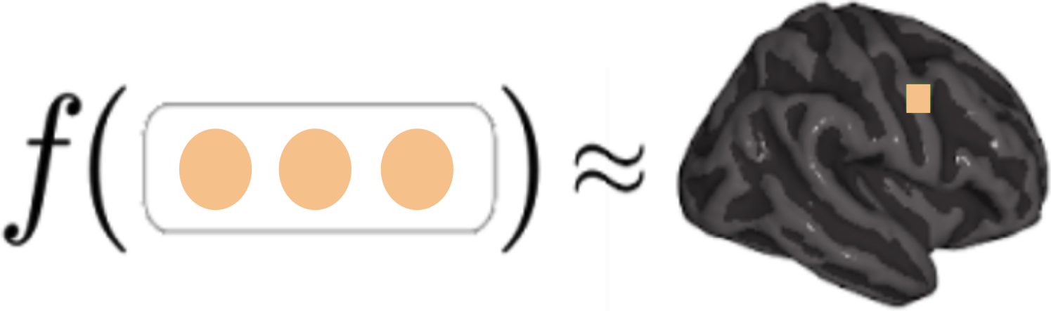
Tasks affect processing
Training language models to summarize narratives improves brain alignment, especially during important narrative elements (Characters, emotions, etc.)
Stimuli: one chapter of Harry Potter
Stimulus representation: summarization-optimized language models
Brain recording & modality: fMRI, reading
Model trained with language modeling
input
input
Model trained to summarize narratives
book chapter
brain alignment (Pearson correlation)
activations
activations
Aw, K.L., and Mariya Toneva. Training language models to summarize narratives improves brain alignment" ICLR 2023

Slide 20
Challenges in using DL for cognitive modeling
Not designed to specifically model brain processing
Training DL models using brain recordings
Task-based modeling
Can be difficult to interpret due to multiple sources of information
Disentangling contributions of different info sources to brain predictions

Slide 21
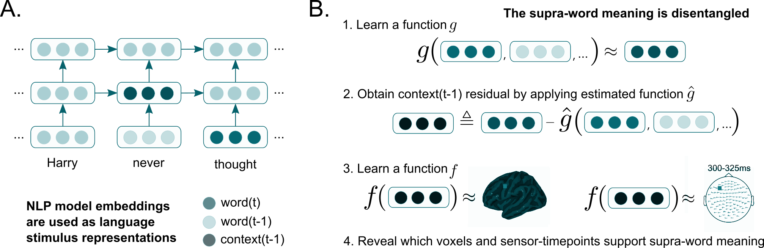
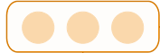
Disentangling contributions of different info sources to brain predictions
“Mary finished the apple”
Isolating supra-word meaning is a type of intervention
supra-word meaning may contain concept of:
eating
apple core
…
supra-word
meaning
Toneva, Mariya, Tom M. Mitchell, and Leila Wehbe. "Combining computational controls with natural text reveals aspects of meaning composition." Nature Computational Science (2022)..

Slide 22
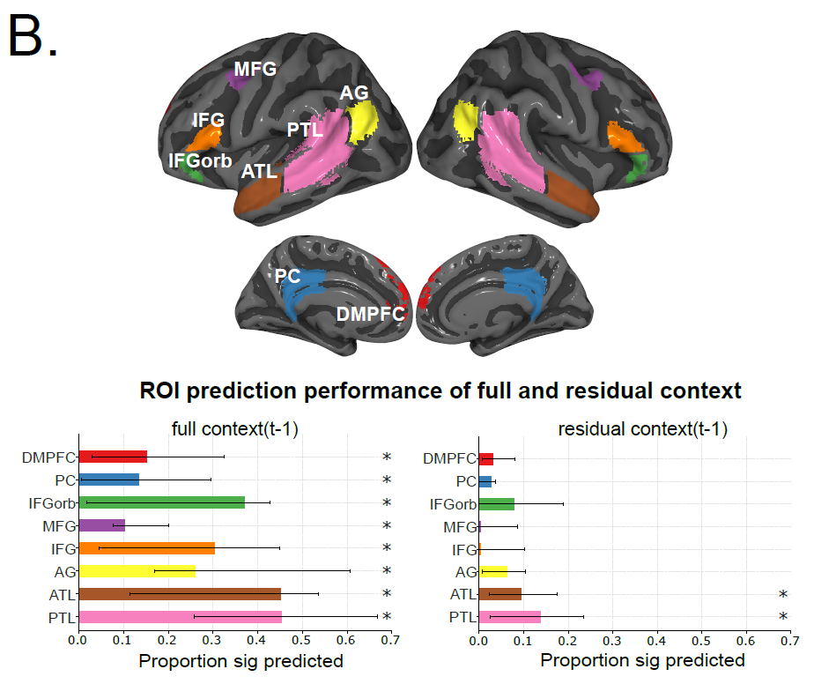
Disentangling contributions of different info sources to brain predictions
Stimuli: one chapter of Harry Potter
Stimulus representation: disentangled embeddings from pretrained NLP models
Brain recording & modality: fMRI & MEG, reading
full context
supra-word
Bilateral PTL and ATL process supra-word meaning
Word-level information important for prediction of most language regions
Toneva, Mariya, Tom M. Mitchell, and Leila Wehbe. "Combining computational controls with natural text reveals aspects of meaning composition." Nature Computational Science (2022)..

Slide 23
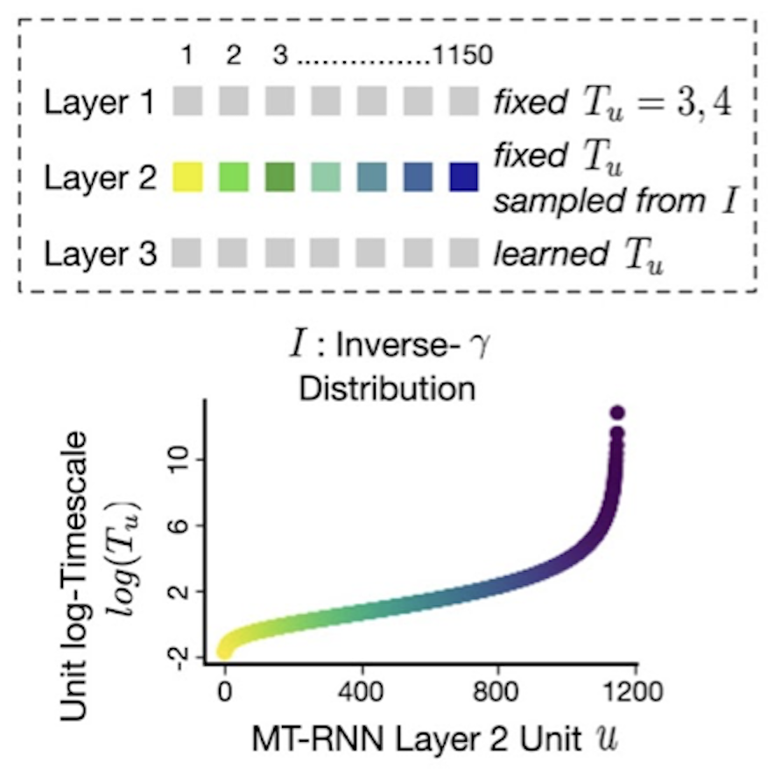
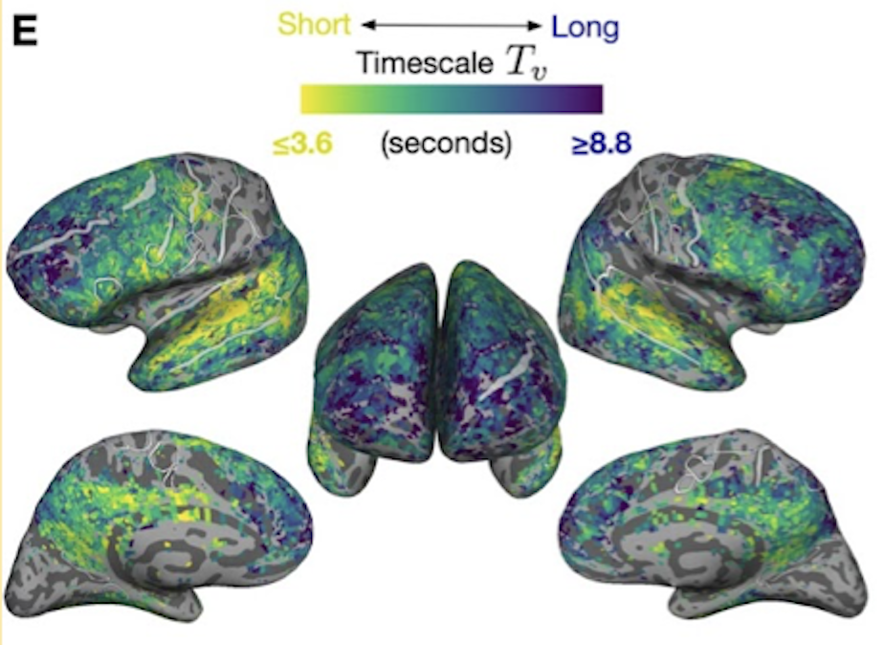
Disentangling contributions of different info sources to brain predictions
Stimuli: story
Stimulus representation: multi-timescale NLP model
Brain recording & modality: fMRI, listening
Utilizing an NLP model that explicitly represents different timescale of information allows the voxel-wise estimation of the preferred timescales
Figures provided by Shailee Jain
Jain, Shailee, Vy Vo, Shivangi Mahto, Amanda LeBel, Javier S. Turek, and Alexander Huth. "Interpretable multi-timescale models for predicting fMRI responses to continuous natural speech." Advances in Neural Information Processing Systems 33 (2020): 13738-13749.

Slide 24
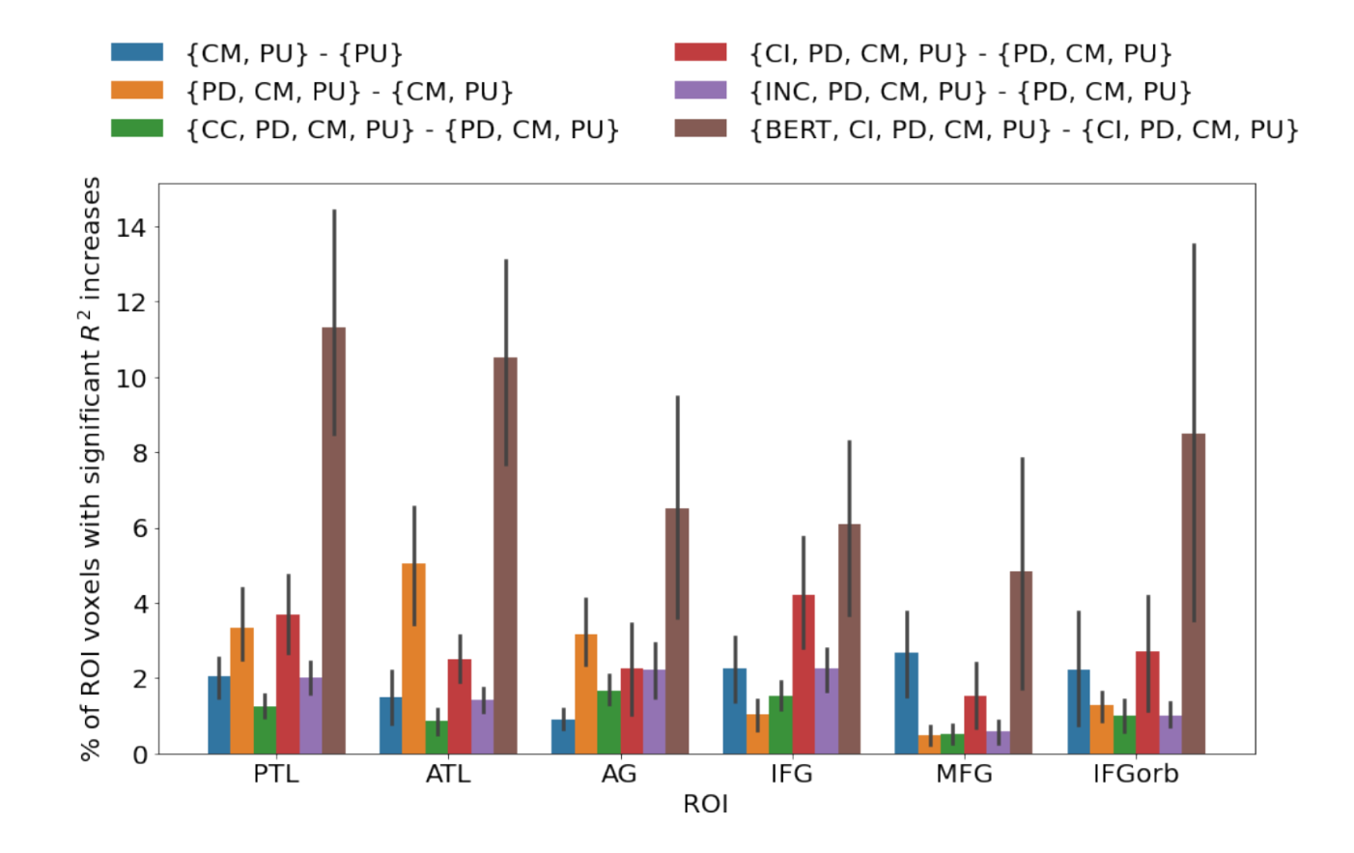
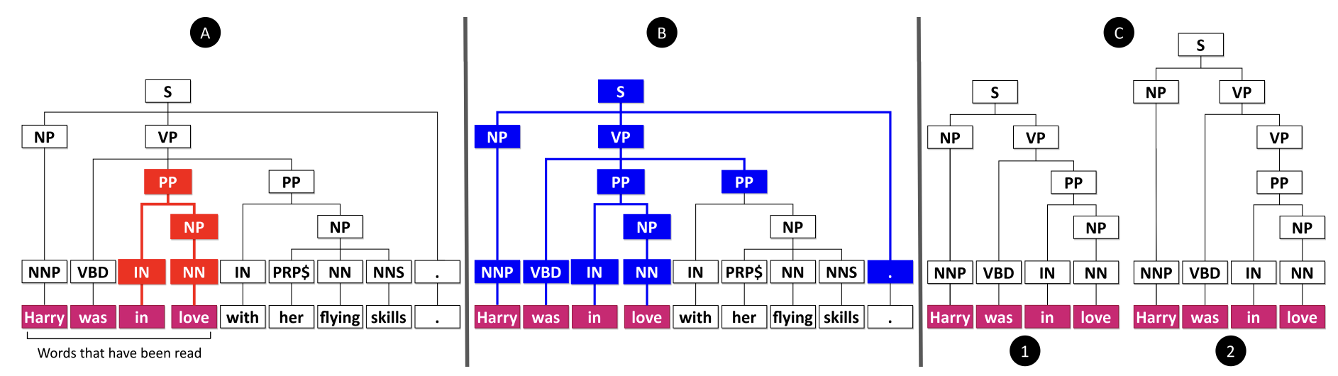
Disentangling contributions of different info sources to brain predictions
Stimuli: one chapter of Harry Potter
Stimulus representation: syntactic tree representations & pretrained NLP model
Brain recording & modality: fMRI, reading
Syntactic structure-based features explain additional variance in language regions over complexity metrics
Regions predicted by syntactic and semantic are difficult to distinguish
Reddy, Aniketh Janardhan, and Leila Wehbe. "Can fMRI reveal the representation of syntactic structure in the brain?." Advances in Neural Information Processing Systems 34 (2021): 9843-9856.

Slide 25
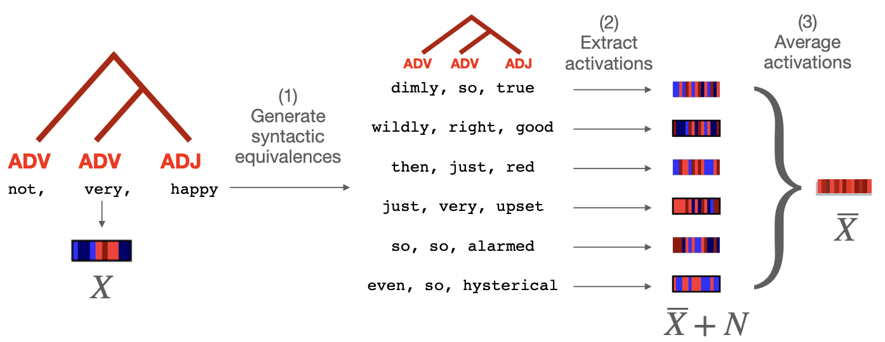
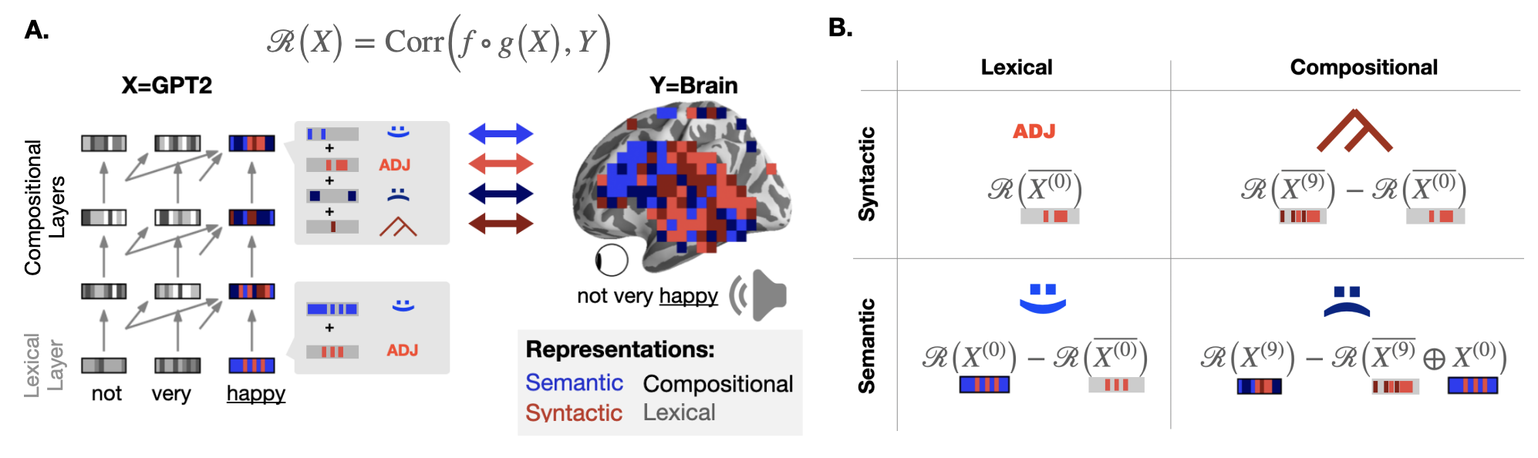
Disentangling contributions of different info sources to brain predictions
Stimuli: story
Stimulus representation: pretrained NLP models
Brain recording & modality: fMRI, listening
Compositional representations recruit a wider cortical network than word-level representations
Syntax and semantics not associated with separate modules
Caucheteux, Charlotte, Alexandre Gramfort, and Jean-Remi King. "Disentangling syntax and semantics in the brain with deep networks." In International Conference on Machine Learning, pp. 1336-1348. PMLR, 2021.

Slide 26
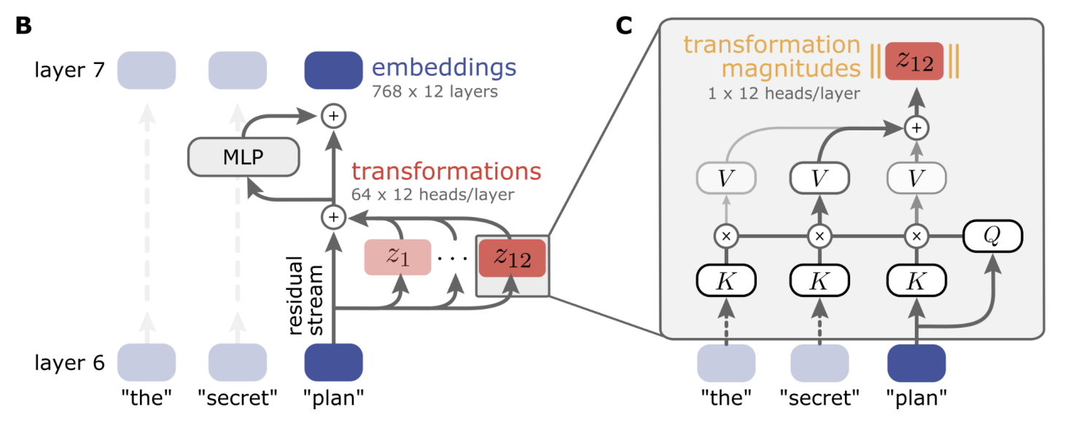
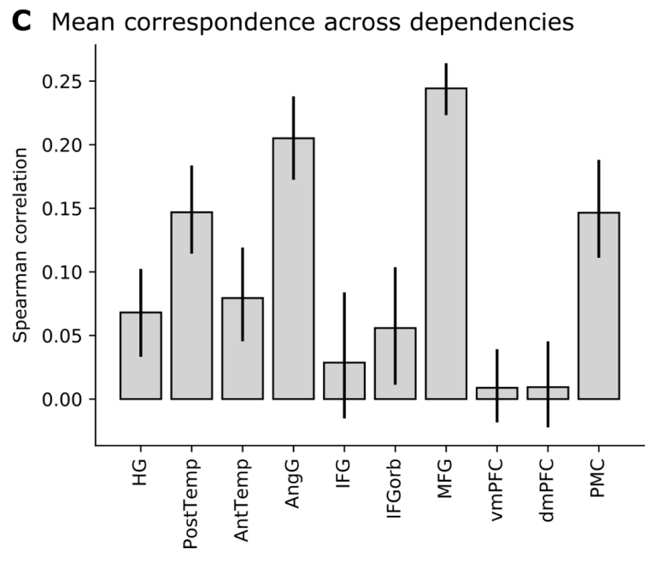
Disentangling contributions of different info sources to brain predictions
Stimuli: story
Stimulus representation: pretrained NLP model
Brain recording & modality: fMRI, listening
Decomposing NLP embeddings into attention heads reveals correlations between syntactic computations and prediction of fMRI recordings
Kumar, Sreejan, Theodore R. Sumers, Takateru Yamakoshi, Ariel Goldstein, Uri Hasson, Kenneth A. Norman, Thomas L. Griffiths, Robert D. Hawkins, and Samuel A. Nastase. "Reconstructing the cascade of language processing in the brain using the internal computations of a transformer-based language model." bioRxiv (2022).

Slide 27
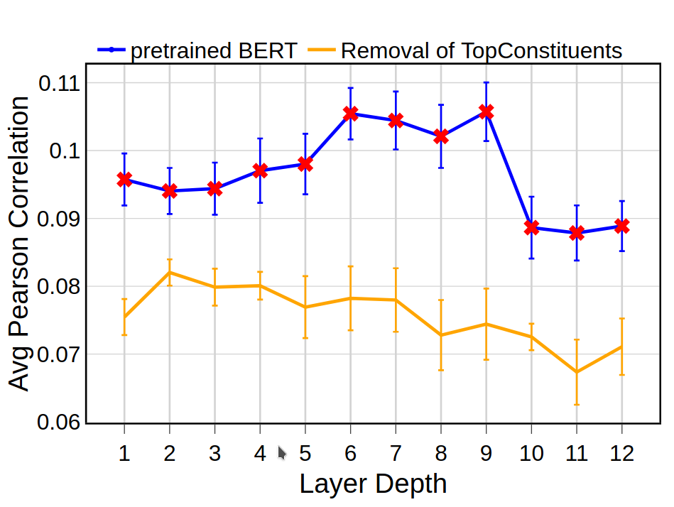
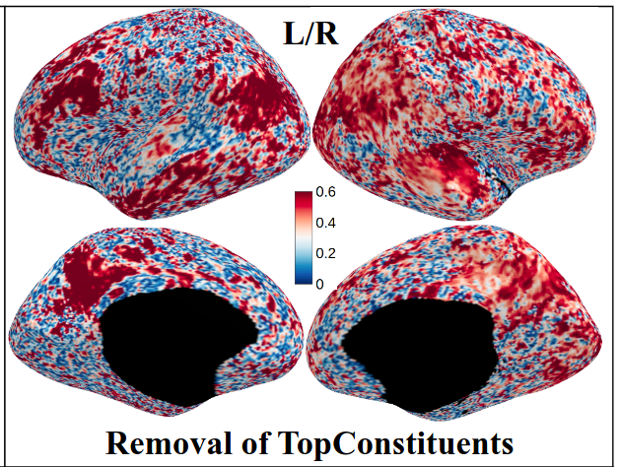
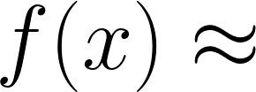




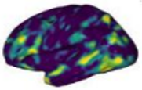
Disentangling contributions of different info sources to brain predictions
Stimuli: story
Stimulus representation: pretrained NLP model
Brain recording & modality: fMRI, listening
Linguistic property
Residual
Syntactic properties contribute the most to the brain alignment trend across layers of language models
This is Los Angeles. And it's the …
Naturalistic stimulus
Language model
Residual brain alignment
Significant difference ⇒Ling. prop. affects alignment
Original brain alignment
fMRI
Oota, S., Manish Gupta, and Mariya Toneva. "Joint processing of linguistic properties in brains and language models" arXiv (2022).

Slide 28


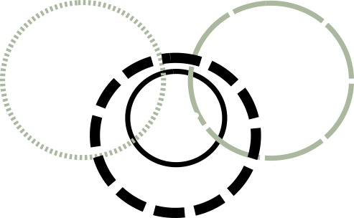
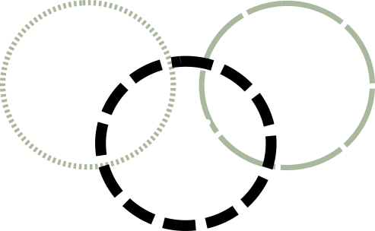

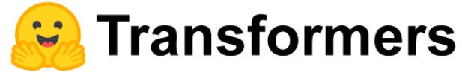
Complex stimulus representations make it difficult to infer the effect of a stimulus on multiple brain areas
Variance in Brain area 1
Variance in Brain area 2
Variance in the stimulus representation
“The problem is when the capsule moves from an elliptical orbit to a parabolic orbit.”
Variance in the stimulus

Slide 29
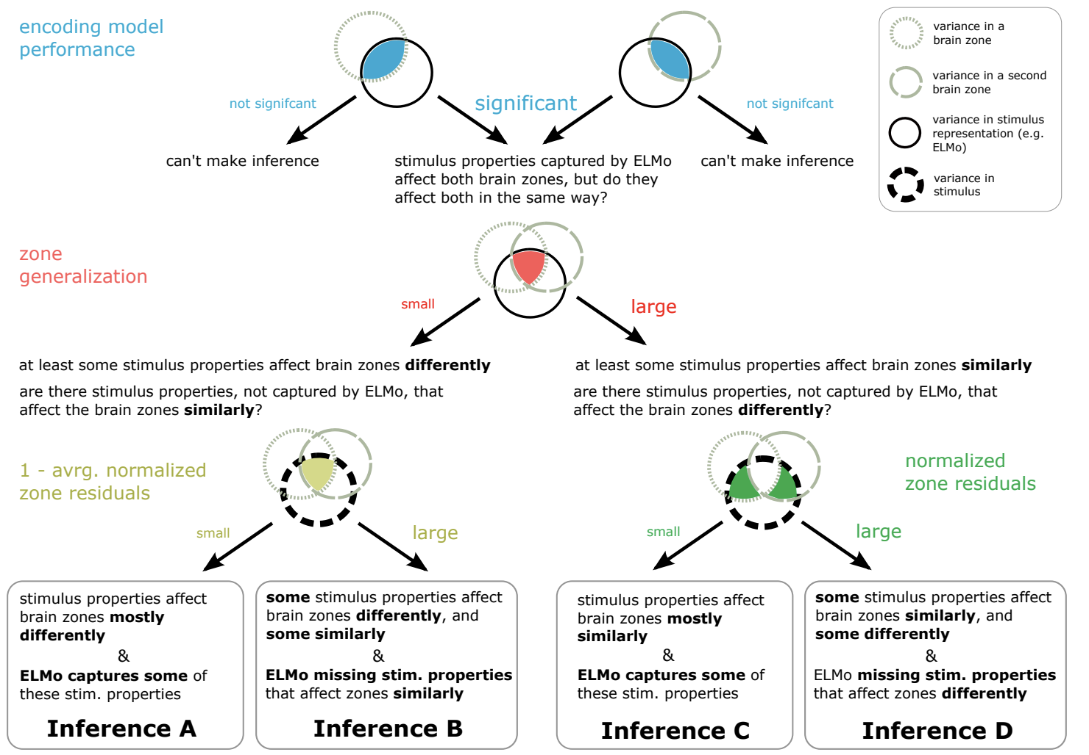
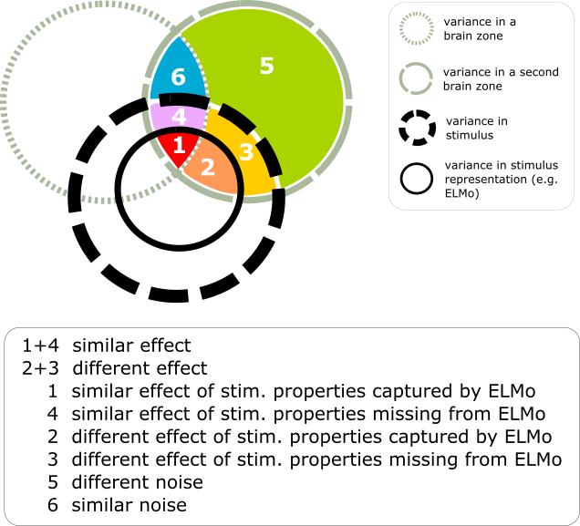
Framework to determine whether a complex stimulus affects two brain areas in a similar way
Toneva, Mariya, Jennifer Williams, Anand Bollu, Christoph Dann, and Leila Wehbe. "Same cause; different effects in the brain." Causal Learning and Reasoning (2022).

Slide 30
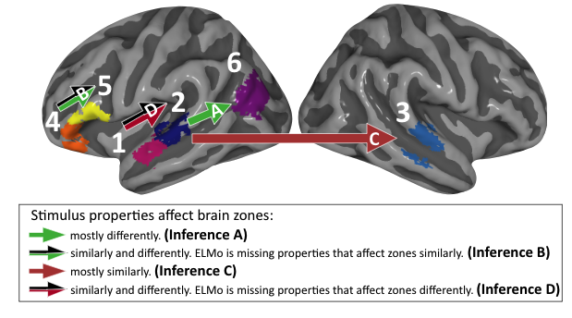
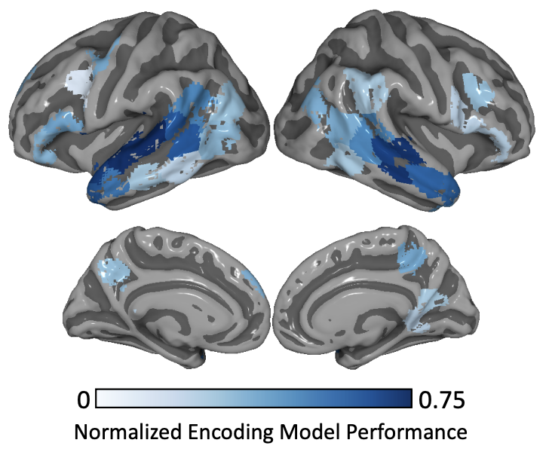
Framework reveals differences in processing across language network areas
Framework reveals differences in processing across language network areas
Stimuli: movie
Stimulus representation: pretrained NLP model
Brain recording & modality: fMRI, view & listen
Example of each type of effect in movie fMRI data
Encoding model perf. significant in all language areas
Toneva, Mariya, Jennifer Williams, Anand Bollu, Christoph Dann, and Leila Wehbe. "Same cause; different effects in the brain." Causal Learning and Reasoning (2022).

Slide 31
Challenges in using DL for cognitive modeling
Not designed to specifically model brain processing
Training DL models using brain recordings
Task-based modeling
Can be difficult to interpret due to multiple sources of information
Disentangling contributions of different info sources to brain predictions

Slide 32
Agenda
Introduction to Brain encoding and decoding [30 min]
Stimulus Representations [1 hour 30 min]
Coffee break [30 min]
Deep Learning for Brain Decoding [1 hour 30 min]
Lunch break [1 hour 15 min]
Deep Learning for Brain Encoding [1 hour 30 min]
Coffee break [30 min]
Advanced Methods [1 hour 15 min]
Summary and Future Trends [15 min]

